Slide 1
3D Image Segmentation and Quantification of Lysosomes
17/11/2025

Slide 2
PROBLEMS LAST MEETING
Incorrect scale values.
Not very good synchronization between the videos.
Inaccurate radius estimation.
Lysosomes located near organelle borders are being classified as outside the cell, even though they should be counted as inside.

Slide 3
Solutions
Scale correction: Verified and corrected the voxel dimensions by checking the image calibration in ImageJ. The voxel scale values (X, Y, Z) are now consistent and accurately applied during metric calculations.
Video synchronization: I managed to establish the same frame rate (fps) in both videos and improve synchronization, as well as ensure that lysosome detection is visible in all cuts so as not to lose tracking.
Radius refinement: Implemented a distance transform (DT)–based refinement. This method re-estimates each lysosome’s radius from the coarse blob_log detections, providing a more geometric and boundary-aware measurement of the true lysosomal size and using better local and generic adaptive threshold for each lysosome.
Boundary inclusion adjustments:
  MARGIN_UM: defines a soft margin (in micrometers) outside the segmented cell mask. Lysosomes within this margin are now correctly counted as inside the cell.
  OVERLAP_ALPHA: sets the minimum overlap fraction (0–1) between a lysosome’s 3D sphere (based on its detected radius) and the cell mask required for it to be classified as inside.
  NEIGHBOR_MAX_VOX: defines the search radius (in voxels) for assigning a lysosome to the nearest cell label when it lies just outside any segmented cell—helping recover lysosomes lost due to erosion or segmentation gaps.

Slide 4
AUTOMATIZATION
Automatic morphology properties:
  CLOSING: Fill small dark holes or gaps inside objects, or close narrow breaks in the mask boundary.
  OPENING: Remove small, isolated bright regions or thin connections (“specks and noise”).
  EROSION: Shrink objects uniformly by eating away their edges.
Parameters needs automatization:
  Lysosomes threshold(blob_log)
  Threshold local(cell mask)
  Minimum sigma
  Maximum sigma
  Number sigma
  MARGIN_UM
  OVERLAP_ALPHA
  NEIGHBOR_MAX_VOX
  Others

Slide 5
Next steps
Optimize σ (sigma) parameter
Continue investigating the optimal sigma range for the blob_log detector to achieve the best balance between sensitivity and accuracy in lysosome detection.
Automate parameter tuning
Implement automated optimization routines for key script parameters (e.g., threshold, sigma values,others) to minimize manual intervention and ensure reproducible results.
Generate static 3D visualizations
Create high-quality static 3D renderings of segmented cells and lysosomes for documentation, figures, and presentations.
Process additional datasets
Expand the analysis to include more image stacks to validate robustness and performance across different imaging conditions.
Set up the environment on the server
Install all required programs, dependencies, and Python libraries on the analysis server to enable remote execution and ensure consistent environments across users.
Implement batch processing
Develop a batch-processing workflow to automatically analyze multiple images or datasets sequentially, improving throughput and efficiency.

Slide 6
FILES
Airy scan_40A_UAS-TMEM-HA_CB_0h_1_051222
Airy scan_40A_UAS-TMEM-HA_CB_0h_2_051222
Airy scan_40A_UAS-TMEM-HA_CB_4h_1_051222
Airy scan_40A_UAS-TMEM-HA_CB_4h_2_051222
TMEM-HA 6h CB airy_3_170722
40A_UAS-TMEM192-3xHA x 40A 71G10 MARCM_around 12h - for quantification_4 Airy-CBs_300425
40A_UAS-TMEM192-3xHA x 40A 71G10 MARCM_around 12h - for quantification_3 Airy-CBs_300425
40A_UAS-TMEM1923x-HA x 71G10 40A MARCM_L3_2_Airy_010724
40A_UAS-TMEM1923x-HA x 71G10 40A MARCM_L3_1_Airy_010724

Slide 7
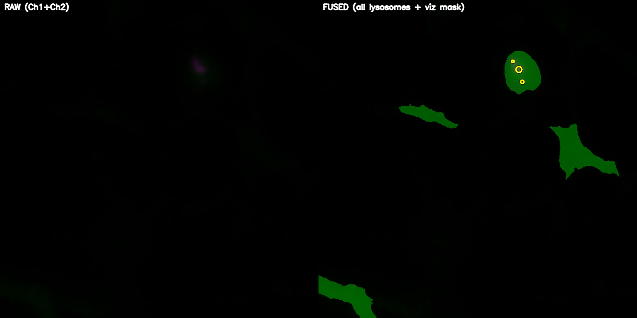
Airy scan_40A_UAS-TMEM-HA_CB_0h_1_051222

Slide 8
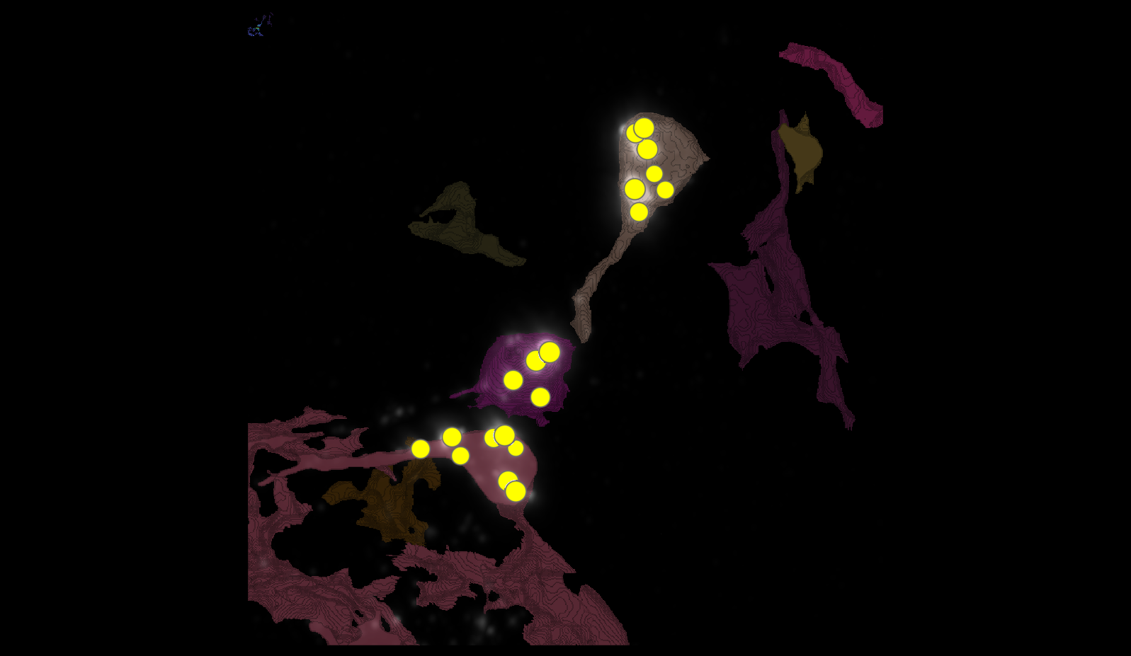
Airy scan_40A_UAS-TMEM-HA_CB_0h_1_051222

Slide 9
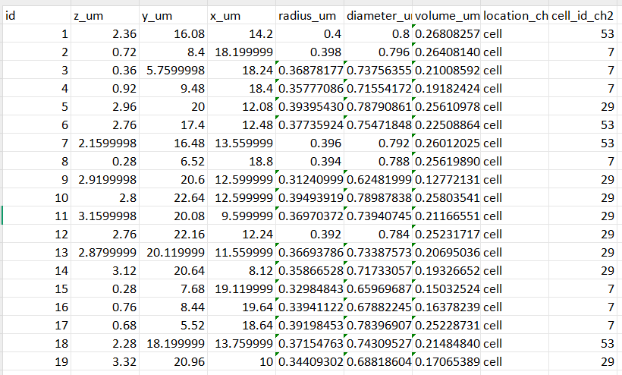
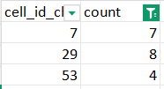

Airy scan_40A_UAS-TMEM-HA_CB_0h_1_051222

Slide 10
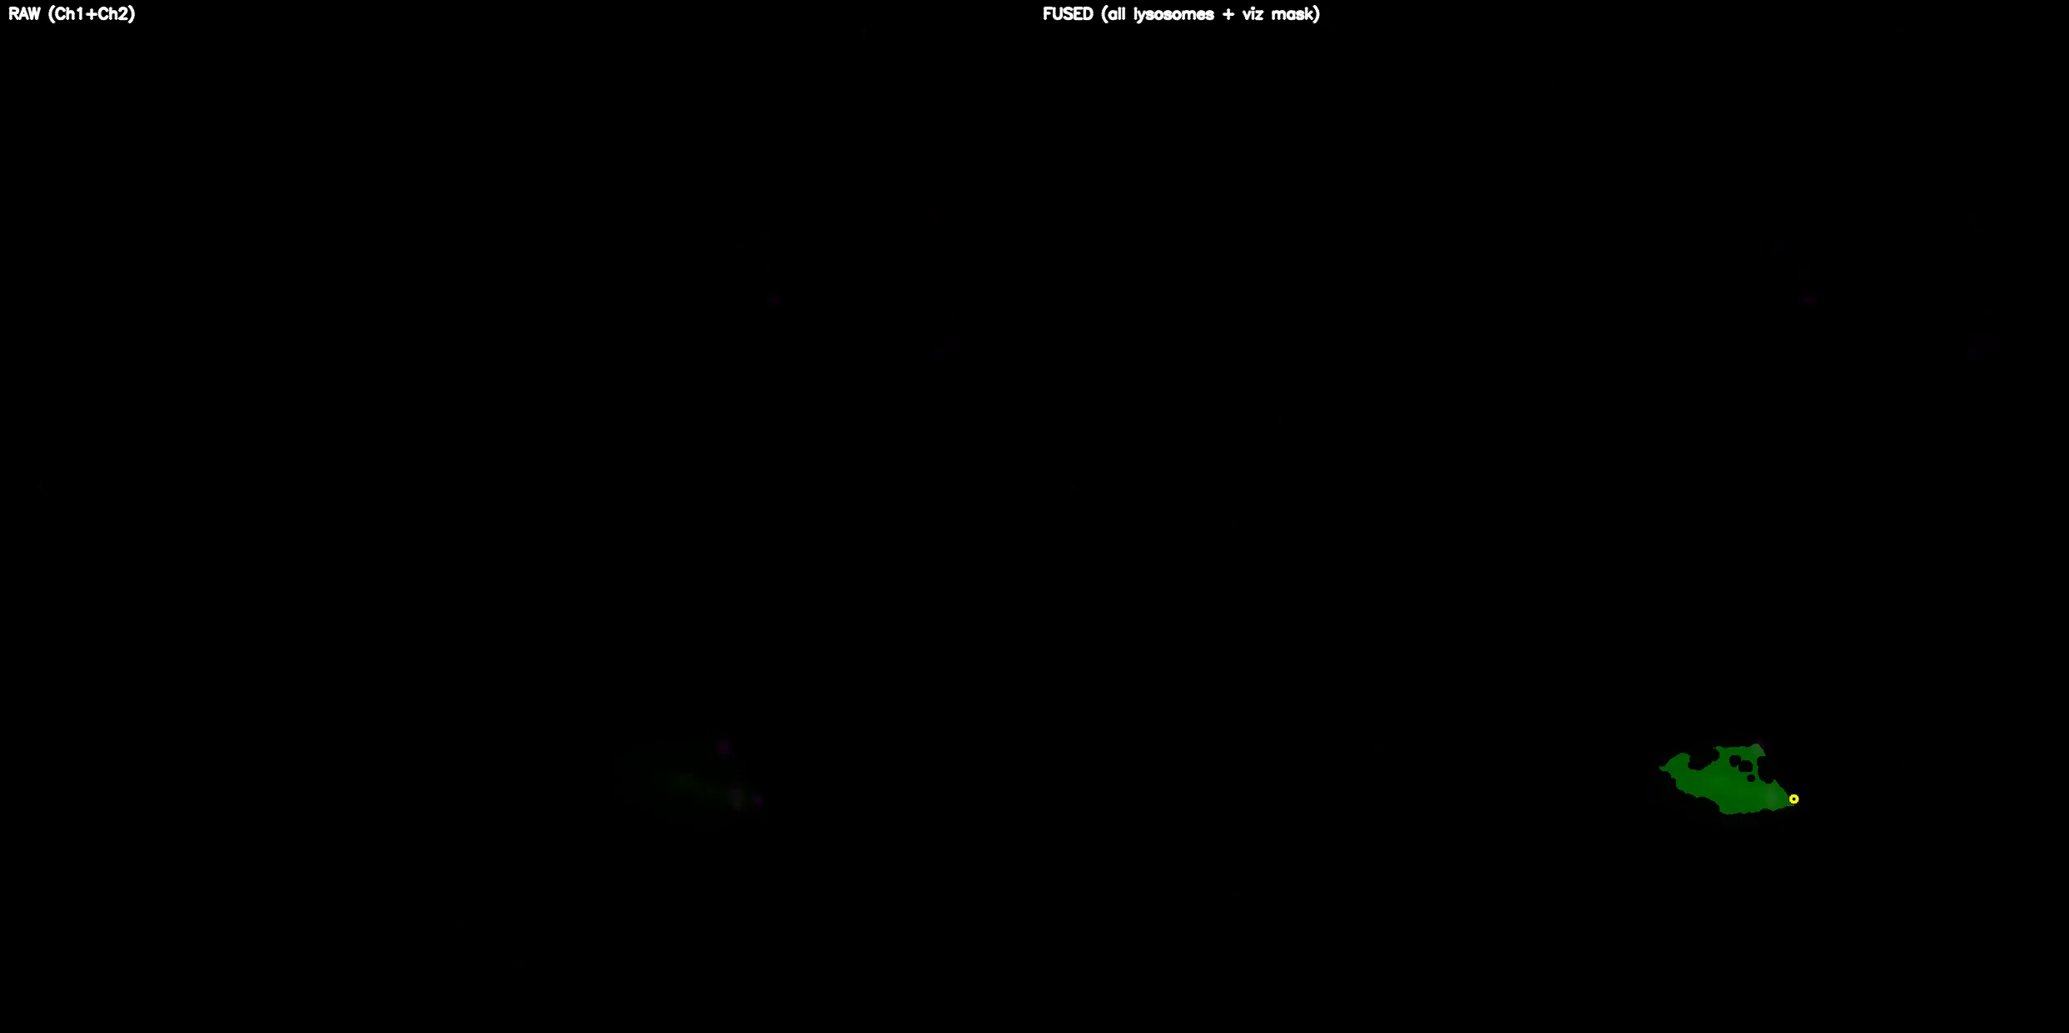
TMEM-HA 6h CB airy_3_170722

Slide 11
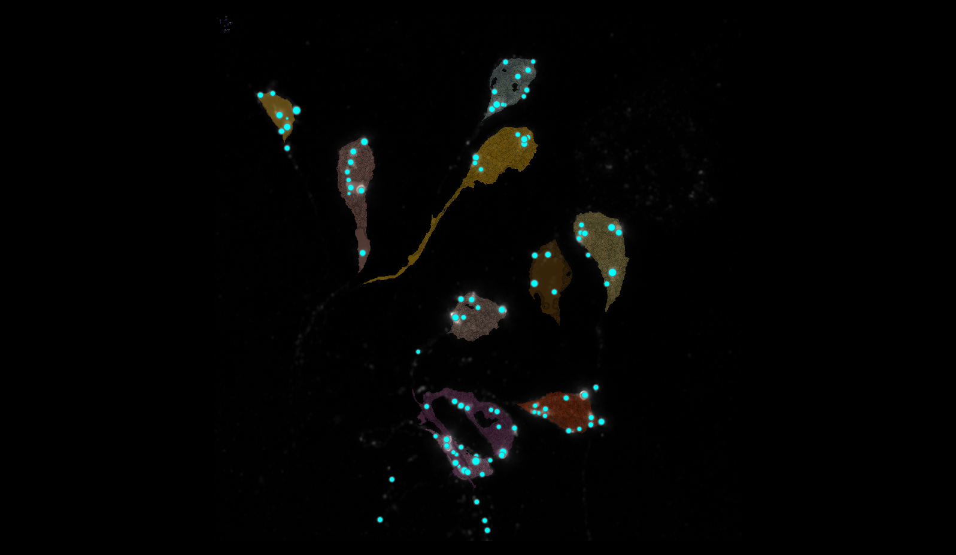
TMEM-HA 6h CB airy_3_170722

Slide 12
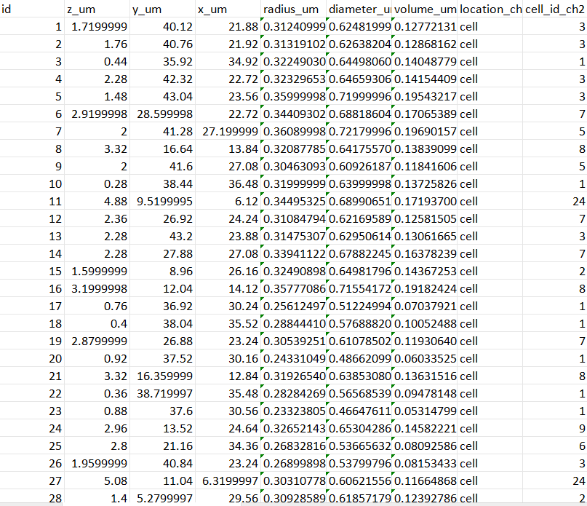

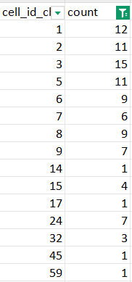
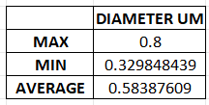
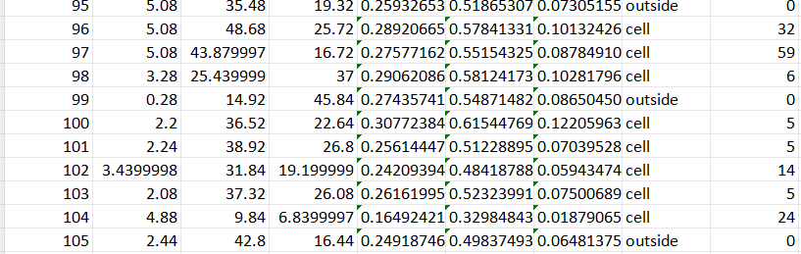
TMEM-HA 6h CB airy_3_170722

Slide 13
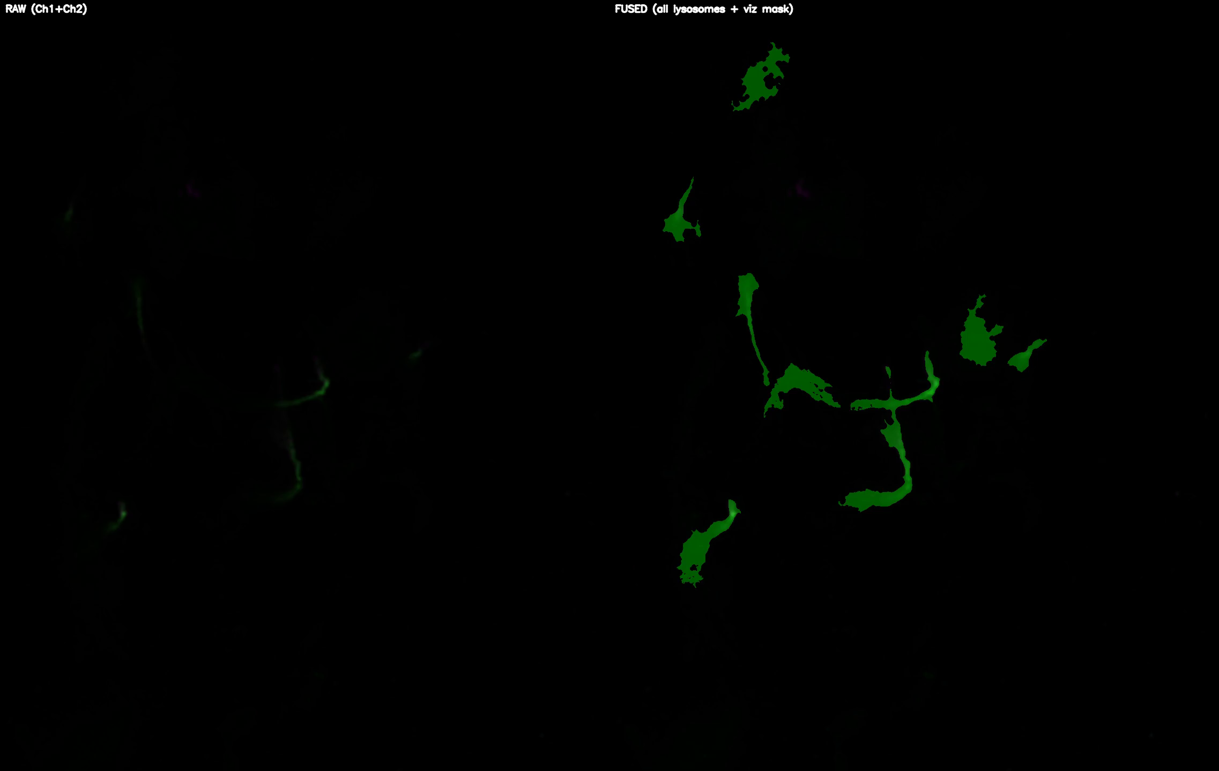
40A_UAS-TMEM192-3xHA x 40A 71G10 MARCM_around 12h - for quantification_3 Airy-CBs_300425

Slide 14
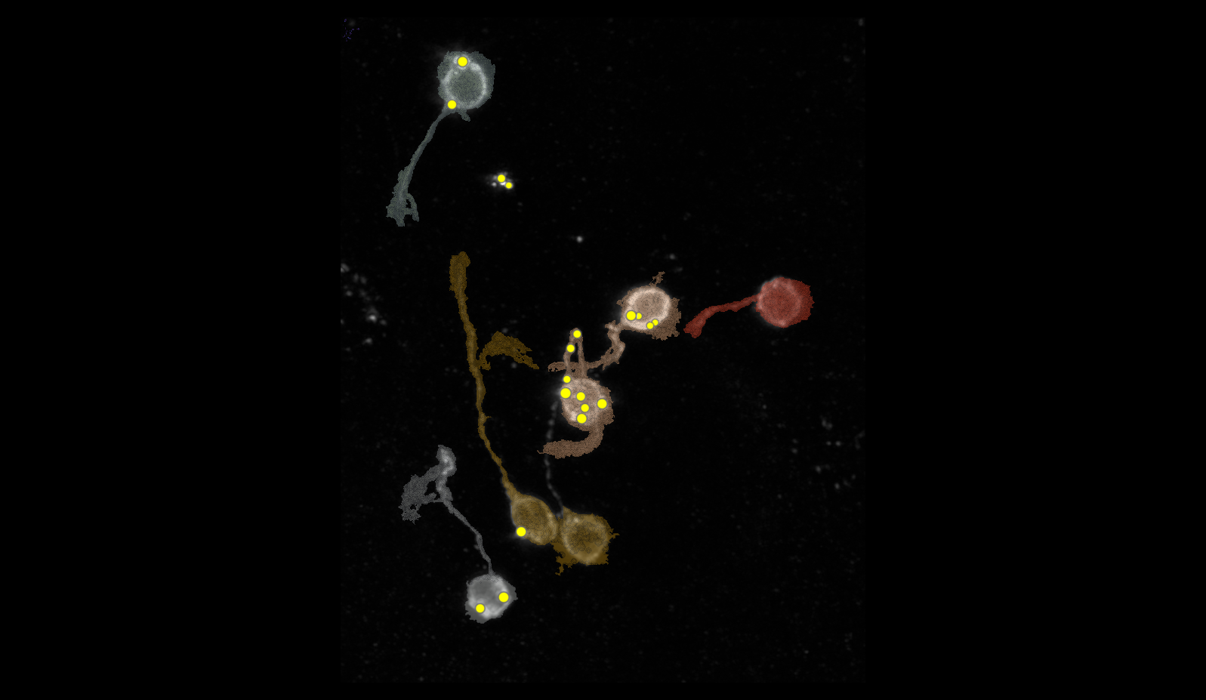
40A_UAS-TMEM192-3xHA x 40A 71G10 MARCM_around 12h - for quantification_3 Airy-CBs_300425

Slide 15
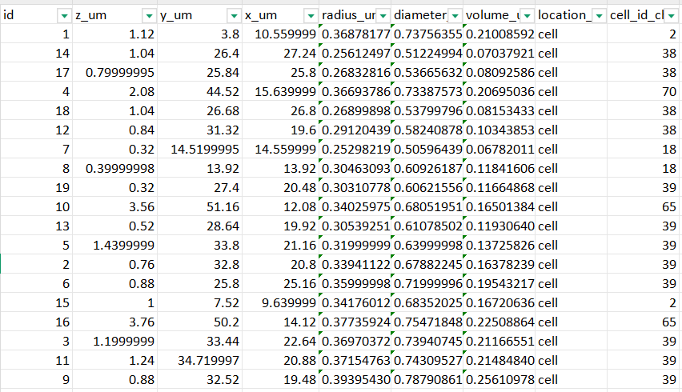
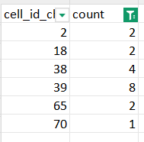

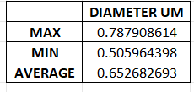
40A_UAS-TMEM192-3xHA x 40A 71G10 MARCM_around 12h - for quantification_3 Airy-CBs_300425

Slide 16
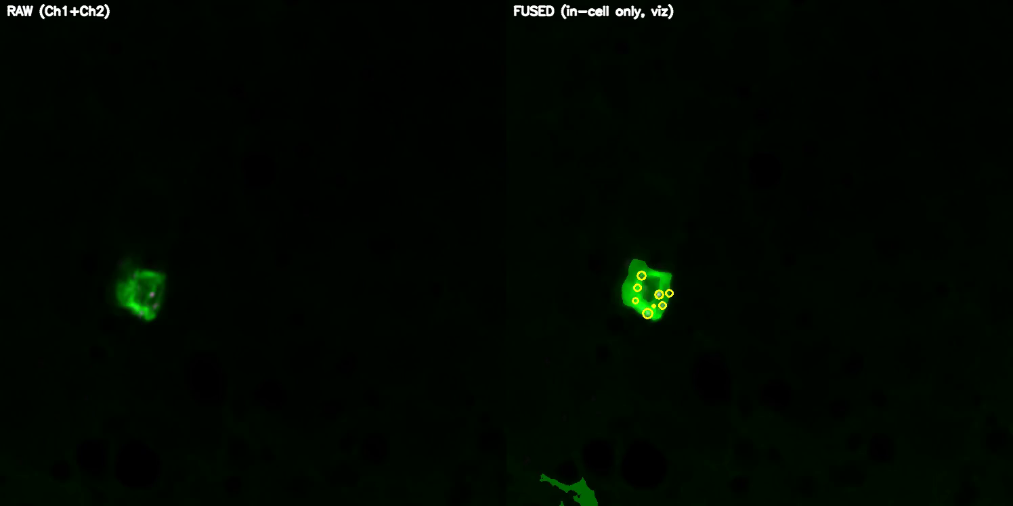
40A_UAS-TMEM1923x-HA x 71G10 40A MARCM_L3_2_Airy_010724

Slide 17
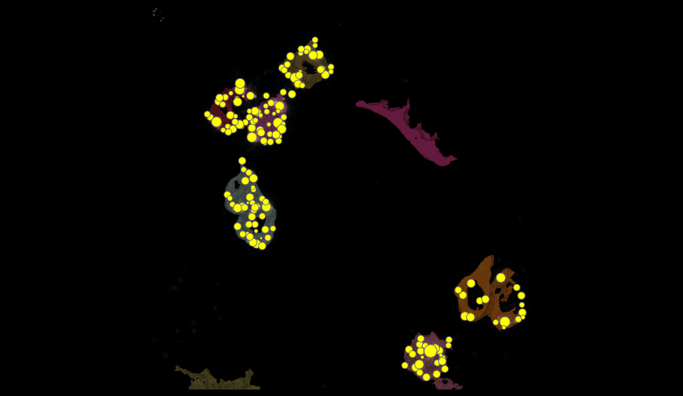
40A_UAS-TMEM1923x-HA x 71G10 40A MARCM_L3_2_Airy_010724
28
96
45
2
85
95

Slide 18
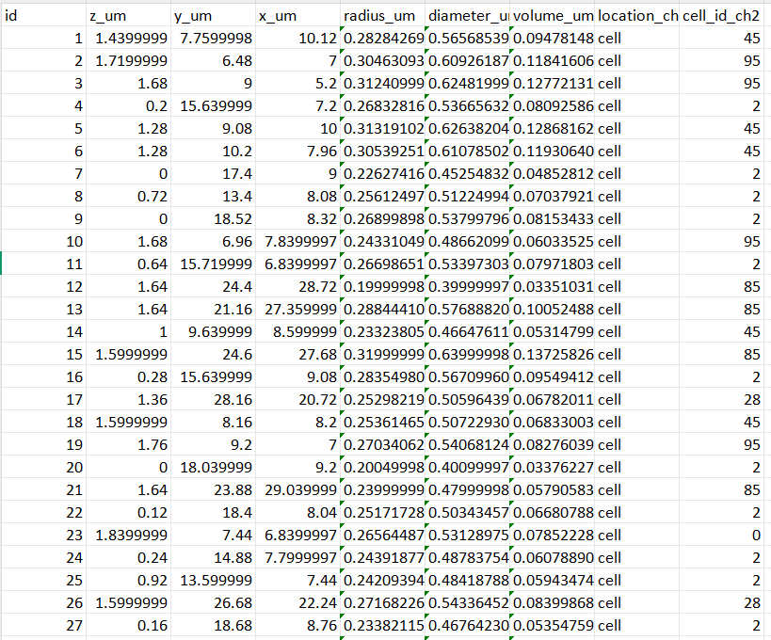
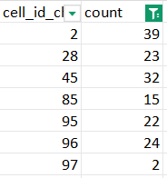

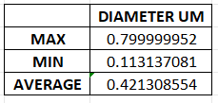
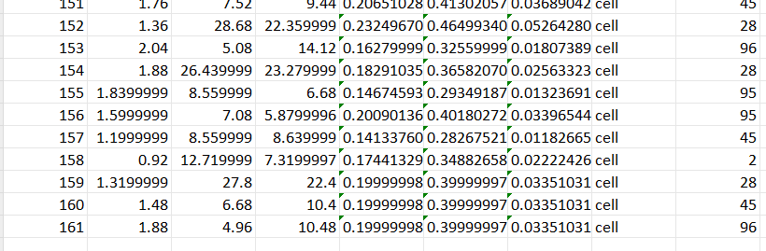
40A_UAS-TMEM1923x-HA x 71G10 40A MARCM_L3_2_Airy_010724
cell | automatic | manual
2 | 39 | NOT DATA
28 | 23 | 30
45 | 32 | 15
85 | 10 | 12
95 | 22 | 20
96 | 24 | 25

